Slide 1
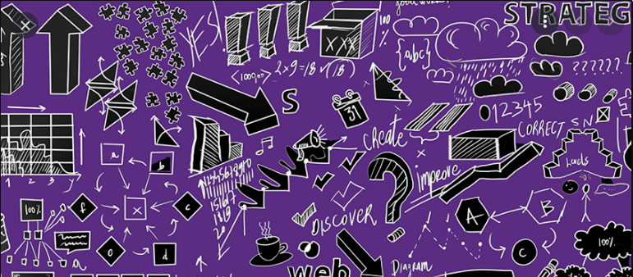
SOFTWARE PROCESS MODELS
ANOUD SHAIKH

Slide 2

Software Process
A software process is the set of activities and associated outcome that produce a software product.
Software engineers mostly carry out these activities.

Slide 3
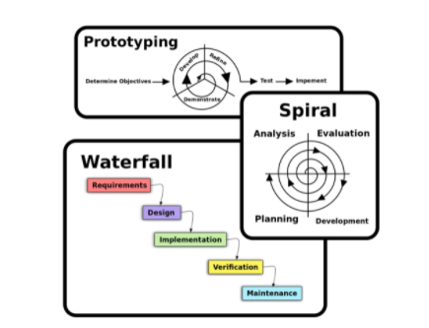
Software Process Model
A software process model is an abstract representation of a process that presents a description of a process from some particular perspective. There are many different software processes but all involve:
Specification – defining what the system should do;
Design and implementation – defining the organization of the system and implementing the system;
Validation – checking that it does what the customer wants;
Evolution – changing the system in response to changing customer needs.

Slide 4
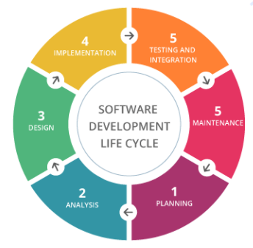
SDLC
SDLC is the acronym of Software Development Life Cycle.
It is also called as Software Development Process.
SDLC is a framework defining tasks performed at each step in the software development process.

Slide 5
SDLC Overview
SDLC is a process followed for a software project, within a software organization.
It consists of a detailed plan describing how to develop, maintain, replace and alter or enhance specific software.
The life cycle defines a methodology for improving the quality of software and the overall development process.

Slide 6
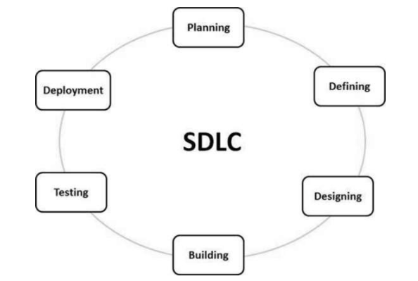
Graphical representation of SDLC
The figure is a graphical representation of the various stages of a typical SDLC.

Slide 7
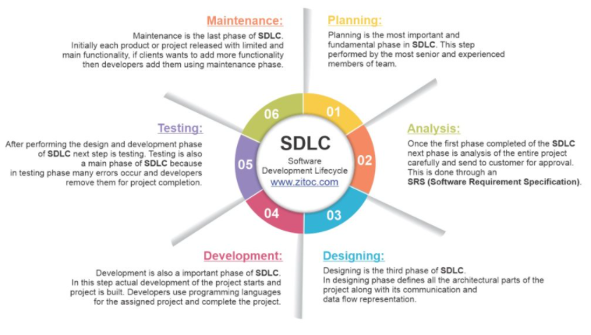
SDLC (contd.)

Slide 8
SDLC (contd.)
There are various software development life cycle models defined and designed which are followed during the software development process.
These models are also referred as “Software Development Process Models". Each process model follows a Series of steps unique to its type to ensure success in the process of software development.
Following are the most important and popular SDLC models followed in the industry −
Waterfall Model
Iterative Model
Spiral Model
V-Model
Big Bang Model
Other related methodologies are Agile Model, RAD Model, Development and Prototyping Models.

Slide 9
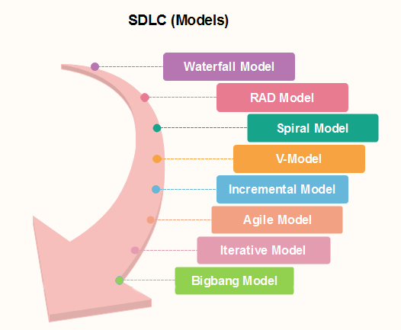
SDLC Models

Slide 10
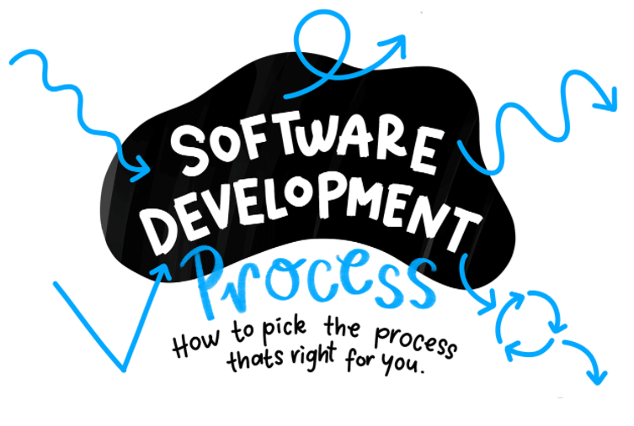

Slide 11

Factors in choosing a Software Process
Choosing the right software process model for your project can be difficult.
If you know your requirements well, it will be easier to select a model that best matches your needs.
You need to keep the following factors in mind when selecting your software process model:

Slide 12
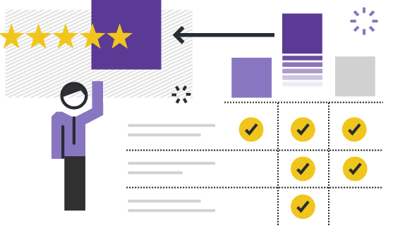

Factors (contd.)
Project Requirements
Project Size
Project Complexity
Cost of Delay
Customer Involvement
Familiarity with technology
Project Resources

Slide 13

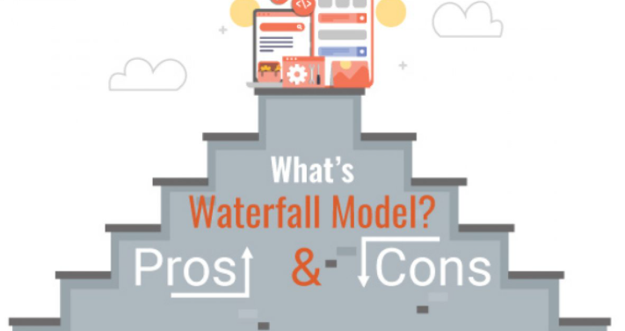
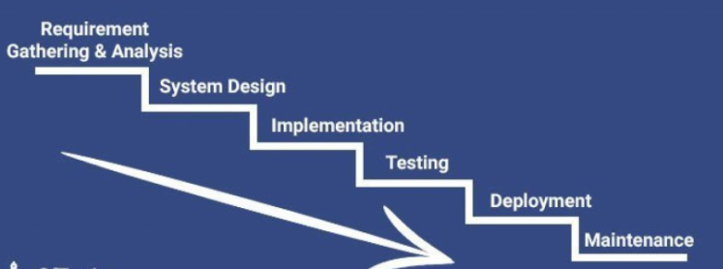
Waterfall Model
The waterfall model is the classic model or the oldest model and is known as mother of all the models.

Slide 14
Waterfall Model (contd.)
The Waterfall Model was the first Process Model to be introduced. It is also referred to as a linear-sequential life cycle model.
It is very simple to understand and use.
In a waterfall model, each phase must be completed before the next phase can begin and there is no overlapping in the phases.
The Waterfall model is the earliest SDLC approach that was used for software development.
The waterfall Model illustrates the software development process in a linear sequential flow.
This means that any phase in the development process begins only if the previous phase is complete. In this waterfall model, the phases do not overlap.

Slide 15
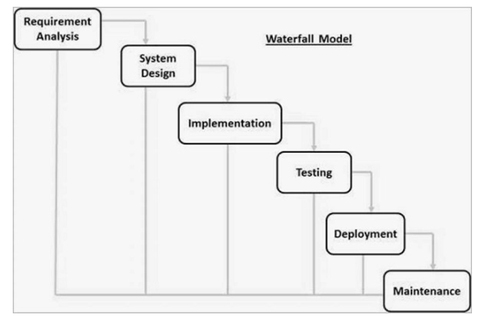
Waterfall Model (contd.)
The waterfall model is a breakdown of project activities into linear sequential phases, where each phase depends on the deliverables of the previous one.
It has the following phases:
Requirements
Design
Implementation
Testing
Deployment
Maintenance

Slide 16
Waterfall Model (contd.)
The sequential phases in Waterfall model are −
Requirement Gathering and analysis − All possible requirements of the system to be developed are captured in this phase and documented in a requirement specification document.
System Design − The requirement specifications from first phase are studied in this phase and the system design is prepared. This system design helps in specifying hardware and system requirements and helps in defining the overall system architecture.
Implementation − With inputs from the system design, the system is first developed in small programs called units, which are integrated in the next phase. Each unit is developed and tested for its functionality, which is referred to as Unit Testing.

Slide 17
Waterfall Model (contd.)
Integration and Testing − All the units developed in the implementation phase are integrated into a system after testing of each unit. Post integration the entire system is tested for any faults and failures.
Deployment of system − Once the functional and non-functional testing is done; the product is deployed in the customer environment or released into the market.
Maintenance − There are some issues which come up in the client environment. To fix those issues, patches are released. Also to enhance the product some better versions are released. Maintenance is done to deliver these changes in the customer environment.
Note:
All these phases are cascaded to each other in which progress is seen as flowing steadily downwards (like a waterfall) through the phases. The next phase is started only after the defined set of goals are achieved for previous phase and it is signed off, so the name "Waterfall Model". In this model, phases do not overlap.

Slide 18
Waterfall Model - Application
Every software developed is different and requires a suitable SDLC approach to be followed based on the internal and external factors. Some situations where the use of Waterfall model is most appropriate are −
Requirements are very well documented, clear and fixed.
Product definition is stable.
Technology is understood and is not dynamic.
There are no ambiguous requirements.
Ample resources with required expertise are available to support the product.
The project is short.

Slide 19
Advantages (SDLC)
Some of the major advantages of the Waterfall Model are as follows −
Simple and easy to understand and use
Easy to manage due to the rigidity of the model. Each phase has specific deliverables and a review process.
Phases are processed and completed one at a time.
Works well for smaller projects where requirements are very well understood.
Clearly defined stages.
Well understood milestones.
Easy to arrange tasks.
Process and results are well documented.

Slide 20
Disadvantages (SDLC)
The major disadvantages of the Waterfall Model are as follows −
No working software is produced until late during the life cycle.
High amounts of risk and uncertainty.
Not a good model for complex and object-oriented projects.
Poor model for long and ongoing projects.
Not suitable for the projects where requirements are at a moderate to high risk of changing. So, risk and uncertainty is high with this process model.
It is difficult to measure progress within stages.
Cannot accommodate changing requirements.
Adjusting scope during the life cycle can end a project.

Slide 21
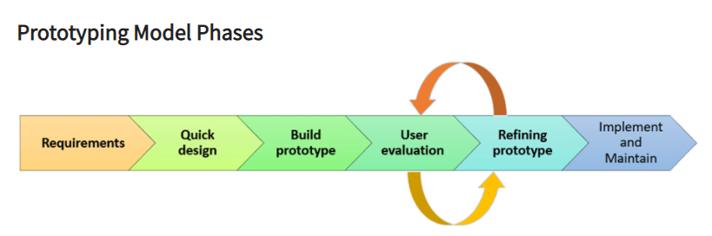
Prototyping Model
Steps of Prototype Model
Requirement Gathering and Analyst
Quick Decision
Build a Prototype
Assessment or User Evaluation
Prototype Refinement
Engineer Product

Slide 22
What is Prototyping Model?
Prototyping Model is a software development model in which prototype is built, tested, and reworked until an acceptable prototype is achieved.
It also creates base to produce the final system or software.
It works best in scenarios where the project's requirements are not known in detail.
It is an iterative, trial and error method which takes place between developer and client.

Slide 23
Prototyping Model (contd.)
Following is a stepwise approach explained to design a software prototype.
Basic Requirement Identification
This step involves understanding the very basics product requirements especially in terms of user interface. The more intricate details of the internal design and external aspects like performance and security can be ignored at this stage.
Developing the initial Prototype
The initial Prototype is developed in this stage, where the very basic requirements are showcased and user interfaces are provided. These features may not exactly work in the same manner internally in the actual software developed. While, the workarounds are used to give the same look and feel to the customer in the prototype developed.
Review of the Prototype
The prototype developed is then presented to the customer and the other important stakeholders in the project. The feedback is collected in an organized manner and used for further enhancements in the product under development.
Revise and Enhance the Prototype
The feedback and the review comments are discussed during this stage and some negotiations happen with the customer based on factors like – time and budget constraints and technical feasibility of the actual implementation. The changes accepted are again incorporated in the new Prototype developed and the cycle repeats until the customer expectations are met.

Slide 24
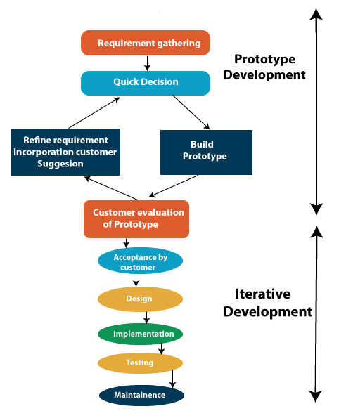
When to use Prototyping model?
Prototype model should be used when the desired system needs to have a lot of interaction with the end users.
Typically, online systems, web interfaces have a very high amount of interaction with end users, are best suited for Prototype model. It might take a while for a system to be built that allows ease of use and needs minimal training for the end user.
Prototyping ensures that the end users constantly work with the system and provide a feedback which is incorporated in the prototype to result in a useable system. They are excellent for designing good human computer interface systems.

Slide 25
Advantages (Prototyping Model)
The advantages of the Prototyping Model are as follows −
Increased user involvement in the product even before its implementation.
Since a working model of the system is displayed, the users get a better understanding of the system being developed.
Reduces time and cost as the defects can be detected much earlier.
Quicker user feedback is available leading to better solutions.
Missing functionality can be identified easily.
Confusing or difficult functions can be identified.

Slide 26
Disadvantages (Prototyping Model)
The Disadvantages of the Prototyping Model are as follows −
Risk of insufficient requirement analysis owing to too much dependency on the prototype.
Users may get confused in the prototypes and actual systems.
Practically, this methodology may increase the complexity of the system as scope of the system may expand beyond original plans
Developers may try to reuse the existing prototypes to build the actual system, even when it is not technically feasible.
The effort invested in building prototypes may be too much if it is not monitored properly.

Slide 27
Software Prototyping Types
Following are the major software prototyping types used widely −
Throwaway/Rapid Prototyping
Throwaway prototyping is also called as rapid or close ended prototyping. This type of prototyping uses very little efforts with minimum requirement analysis to build a prototype. Once the actual requirements are understood, the prototype is discarded and the actual system is developed with a much clear understanding of user requirements.
Evolutionary Prototyping
Evolutionary prototyping also called as breadboard prototyping is based on building actual functional prototypes with minimal functionality in the beginning. The prototype developed forms the heart of the future prototypes on top of which the entire system is built. By using evolutionary prototyping, the well-understood requirements are included in the prototype and the requirements are added as and when they are understood.

Slide 28
Software Prototyping Types (contd.)
Incremental Prototyping
Incremental prototyping refers to building multiple functional prototypes of the various sub-systems and then integrating all the available prototypes to form a complete system.
Extreme Prototyping
Extreme prototyping is used in the web development domain. It consists of three sequential phases. First, a basic prototype with all the existing pages is presented in the HTML format. Then the data processing is simulated using a prototype services layer. Finally, the services are implemented and integrated to the final prototype. This process is called Extreme Prototyping used to draw attention to the second phase of the process, where a fully functional UI is developed with very little regard to the actual services.

Slide 29
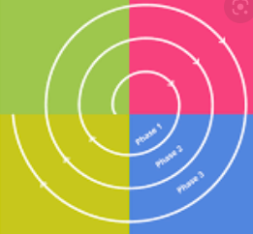
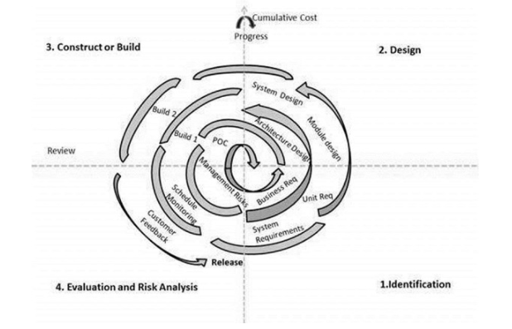
Spiral Model
The illustration is a representation of the Spiral Model, listing the activities in each phase.

Slide 30
Spiral Model (contd.)
The spiral model combines the idea of iterative development with the systematic, controlled aspects of the waterfall model.
This Spiral model is a combination of iterative development process model and sequential linear development model i.e. the waterfall model with a very high emphasis on risk analysis.
It allows incremental releases of the product or incremental refinement through each iteration around the spiral.

Slide 31
The 4 Phases of Spiral Model
The spiral model has four phases. A software project repeatedly passes through these phases in iterations called Spirals.
Identification
This phase starts with gathering the business requirements in the baseline spiral. In the subsequent spirals as the product matures, identification of system requirements, subsystem requirements and unit requirements are all done in this phase.
This phase also includes understanding the system requirements by continuous communication between the customer and the system analyst. At the end of the spiral, the product is deployed in the identified market.
Design
The Design phase starts with the conceptual design in the baseline spiral and involves architectural design, logical design of modules, physical product design and the final design in the subsequent spirals.

Slide 32
The 4 Phases of Spiral Model (contd.)
Construct or Build
The Construct phase refers to production of the actual software product at every spiral. In the baseline spiral, when the product is just thought of and the design is being developed a POC (Proof of Concept) is developed in this phase to get customer feedback.
Then in the subsequent spirals with higher clarity on requirements and design details a working model of the software called build is produced with a version number. These builds are sent to the customer for feedback.
Evaluation and Risk Analysis
Risk Analysis includes identifying, estimating and monitoring the technical feasibility and management risks, such as schedule slippage and cost overrun. After testing the build, at the end of first iteration, the customer evaluates the software and provides feedback.
Based on the customer evaluation, the software development process enters the next iteration and subsequently follows the linear approach to implement the feedback suggested by the customer. The process of iterations along the spiral continues throughout the life of the software.

Slide 33
Spiral Model Application
The following pointers explain the typical uses of a Spiral Model −
When there is a budget constraint and risk evaluation is important.
For medium to high-risk projects.
Long-term project commitment because of potential changes to economic priorities as the requirements change with time.
Customer is not sure of their requirements which is usually the case.
Requirements are complex and need evaluation to get clarity.
New product line which should be released in phases to get enough customer feedback.
Significant changes are expected in the product during the development cycle.

Slide 34
Advantages (Spiral Model)
The advantages of the Spiral SDLC Model are as follows −
Changing requirements can be accommodated.
Allows extensive use of prototypes.
Requirements can be captured more accurately.
Users see the system early.
Development can be divided into smaller parts and the risky parts can be developed earlier which helps in better risk management.

Slide 35
Disadvantages (Spiral Model)
The disadvantages of the Spiral SDLC Model are as follows −
Management is more complex.
End of the project may not be known early.
Not suitable for small or low risk projects and could be expensive for small projects.
Process is complex
Spiral may go on indefinitely.
Large number of intermediate stages requires excessive documentation.

Slide 36

Any Questions ?

